Slide 1
Mushroom Edibility Classification
Will Chan

Slide 2
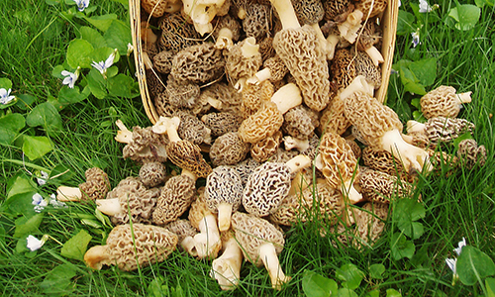
Motivation
Mushroom Hunting
Domain Knowledge
Practice
Notes:
Motivations: common activity i do with friends was mushroom hunting
I have some domain knowledge of mushrooms and good to have before working on any dataset
Good practice as I have never worked on a classification dataset before for a project

Slide 3
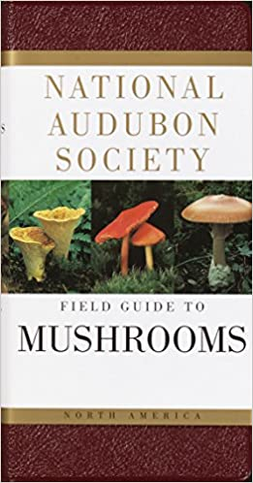
Dataset
Source: UCI Machine Learning Repository
Source from 1981 Reference Book
8124 rows, 23 Records
After data munging, 22 records
Categorical Nominal
Notes:
For edible mushrooms its best to stikc with what you can recognize if you dont know it best not eat it

Slide 4
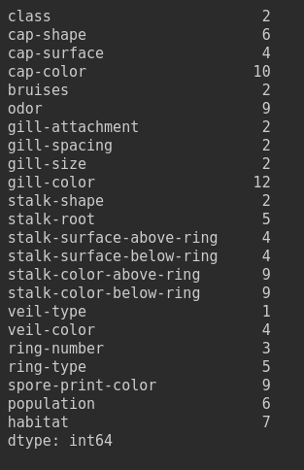
Data Wrangling
Drop Low Variety Columns
Veil Type
Missing Values
Stalk Roots
2480 missing values
~30% of data
Imputation?

Slide 5
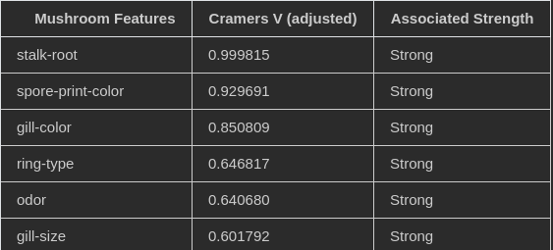
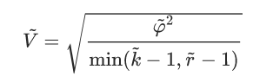
Data Wrangling cont.
Determining Missingness
MCAR
MAR
MNCAR
Adjusted Cramer’s V
Strong > 0.5, Moderate > 0.3, Weak > 0.1
Imputation via predict Modeling
Notes:
Adjusted Cramers V determines whether variables (nominal) are related to each other or they are independent
And so to see whehte r
adjust ed cramers v is different in that has bias correction, which uses a smaller msq in estimate the population quantity
Perform cramers V of missing values of stalk root (there were 7 strong associated features)
Made a separate dataset feature for missingness of data
Then obtained Cramers V scores for mushroom features in dataset to see if relations are strong or not; if strong it meast its not missing at random and makes sense to compute
Then used those strong associated features to impute the missing value for stalk roots

Slide 6
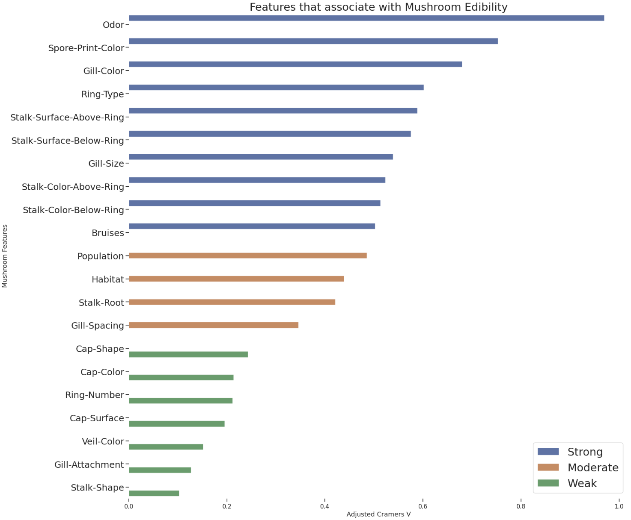
Exploratory Data Analysis + Stats Questions
What mushroom characteristics most associate with mushroom edibility?
Strong Features
Odor, Spore-Print-Color, Gill-Color, Ring-Type
Stalk-Surface-Above-Ring, Stalk-Surface-Below-Ring
Gill-Size, Stalk-Color-Above-Ring
Stalk-Color-Below-Ring

Slide 7
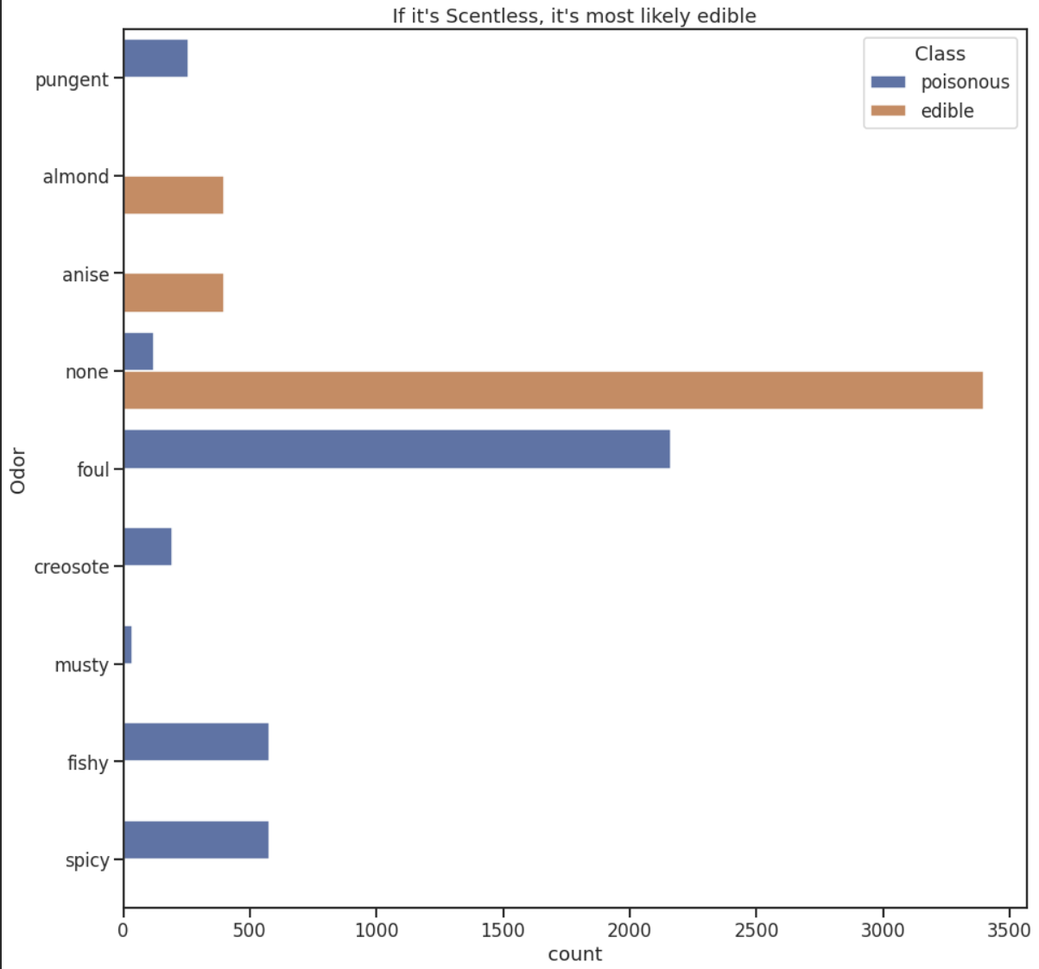
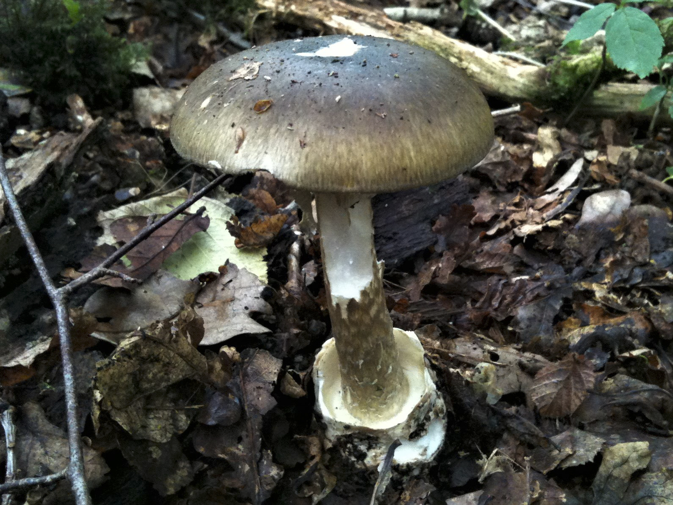
Mushroom Edibility Features
Scentless are most likely edibility
Almond, Anise
Notes:
Cresote means smokey spell
Picture of a deathcap (smells like ammonia) i wouldnt smell mushroom
But most edible mushrooms ive eaten smell like mushrooms, or earth

Slide 8
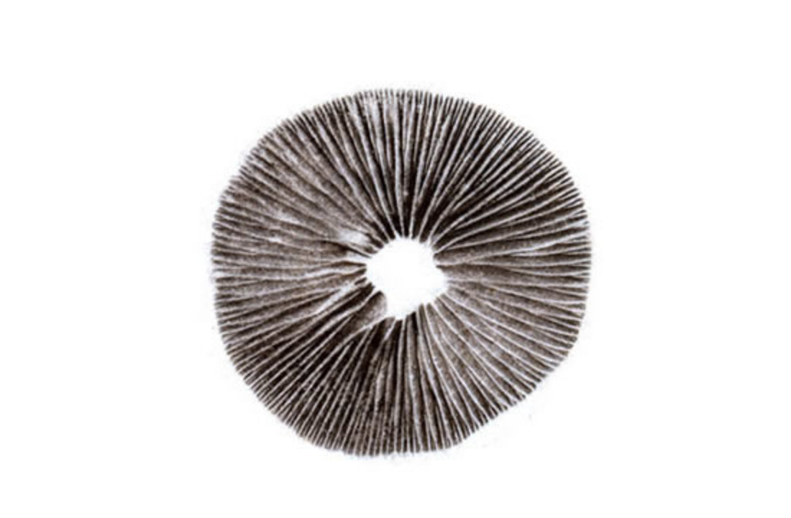
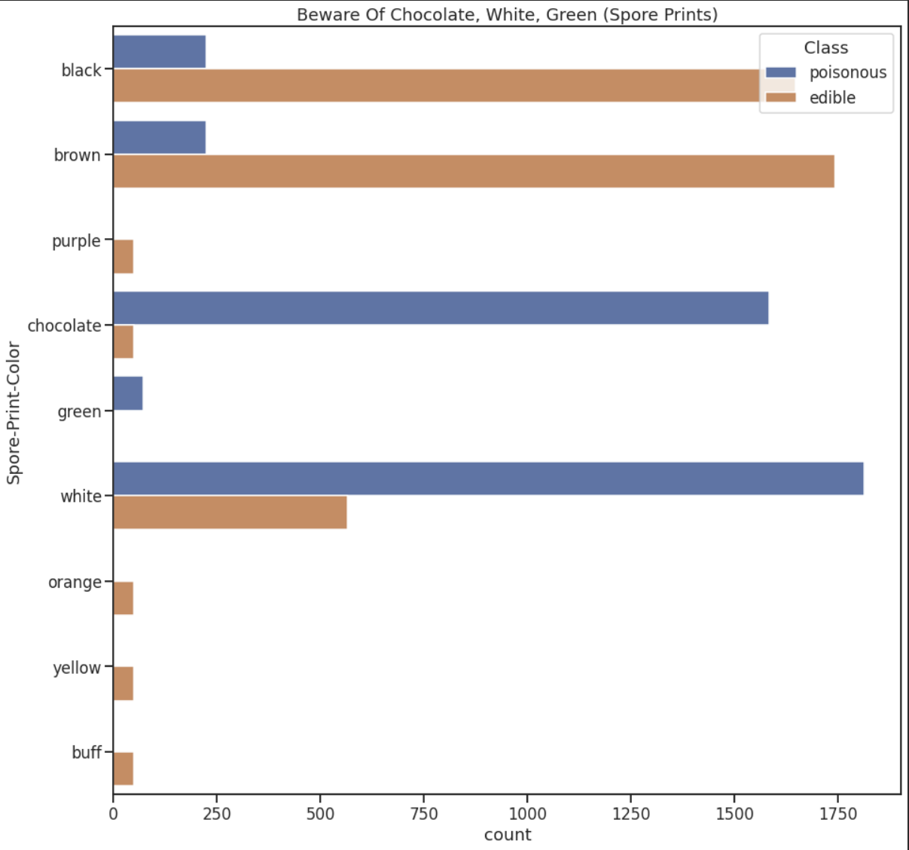
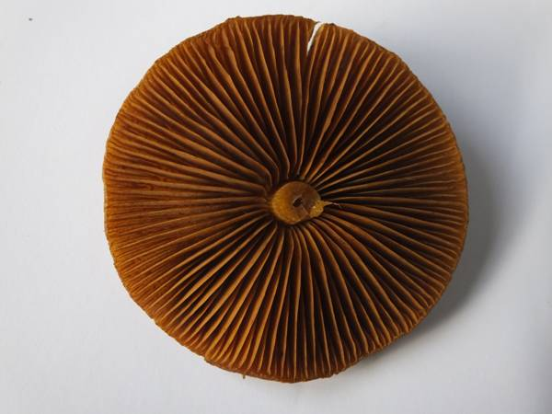
Wary of Chocolate, White, Green
Notes:
Spore prints that are most poisonous seem to be these colors
Also spore prints are what is found falling out of the gills
Not many mushrooms with purple, orange, yellow and buff print colors

Slide 9
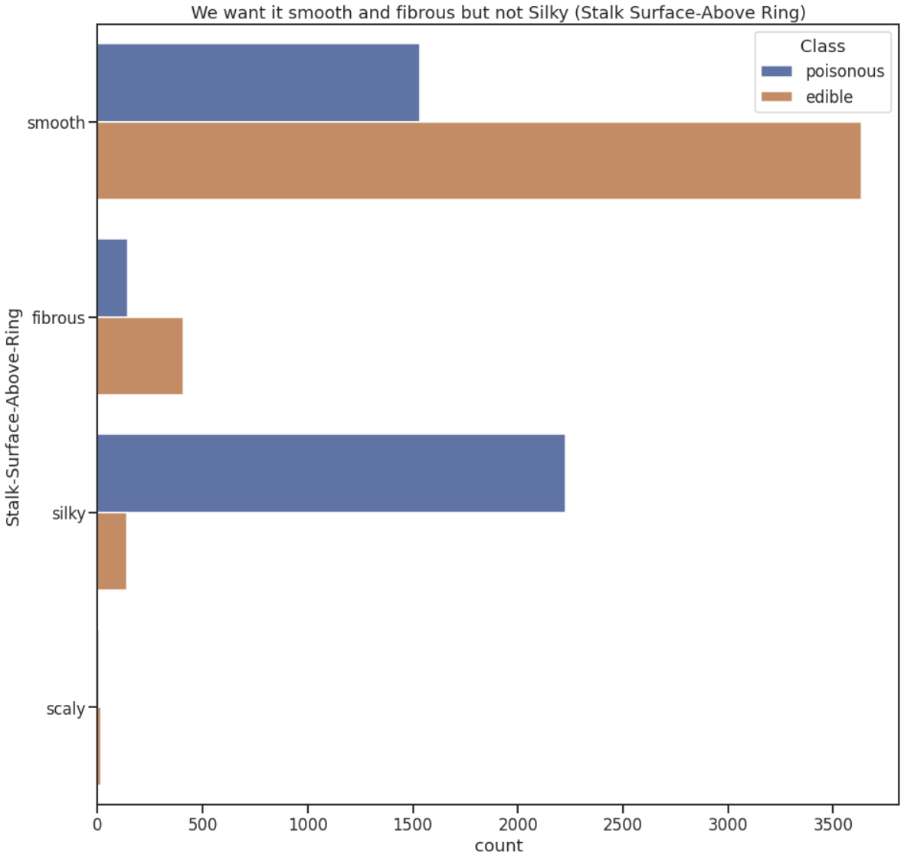
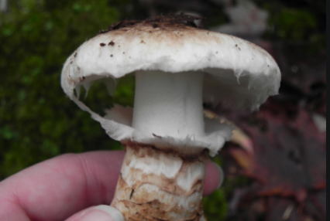
Smooth and Fibrous but not Silky (Stalk Surface)

Slide 10
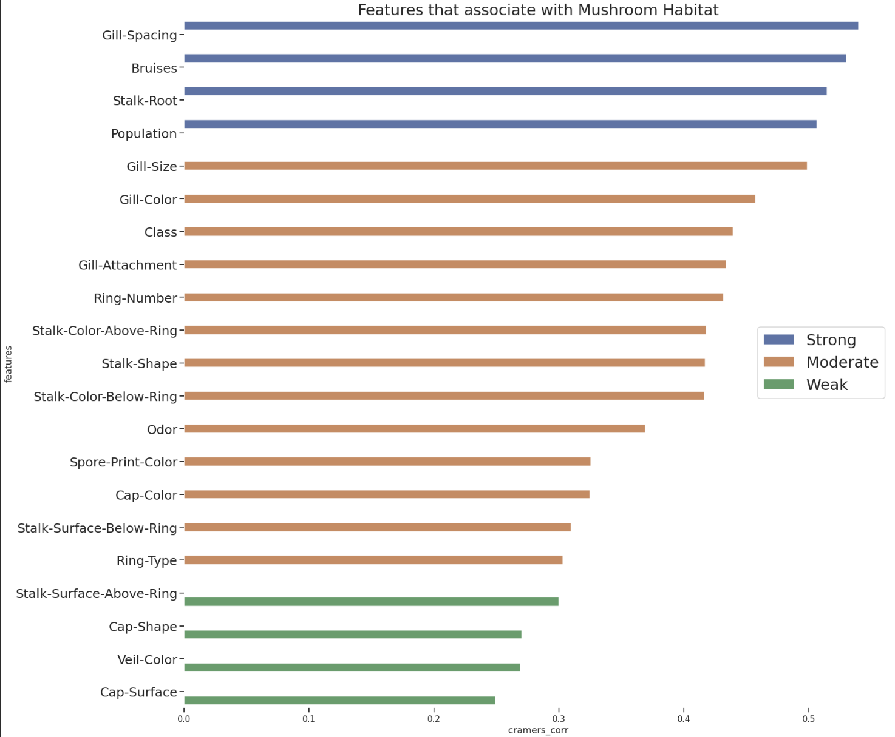
EDA features associated with Mushroom Habitat
What features most associate with Mushroom Habitat?
Strong Features
Gill-Spacing
Bruising
Stalk-Root
Population

Slide 11
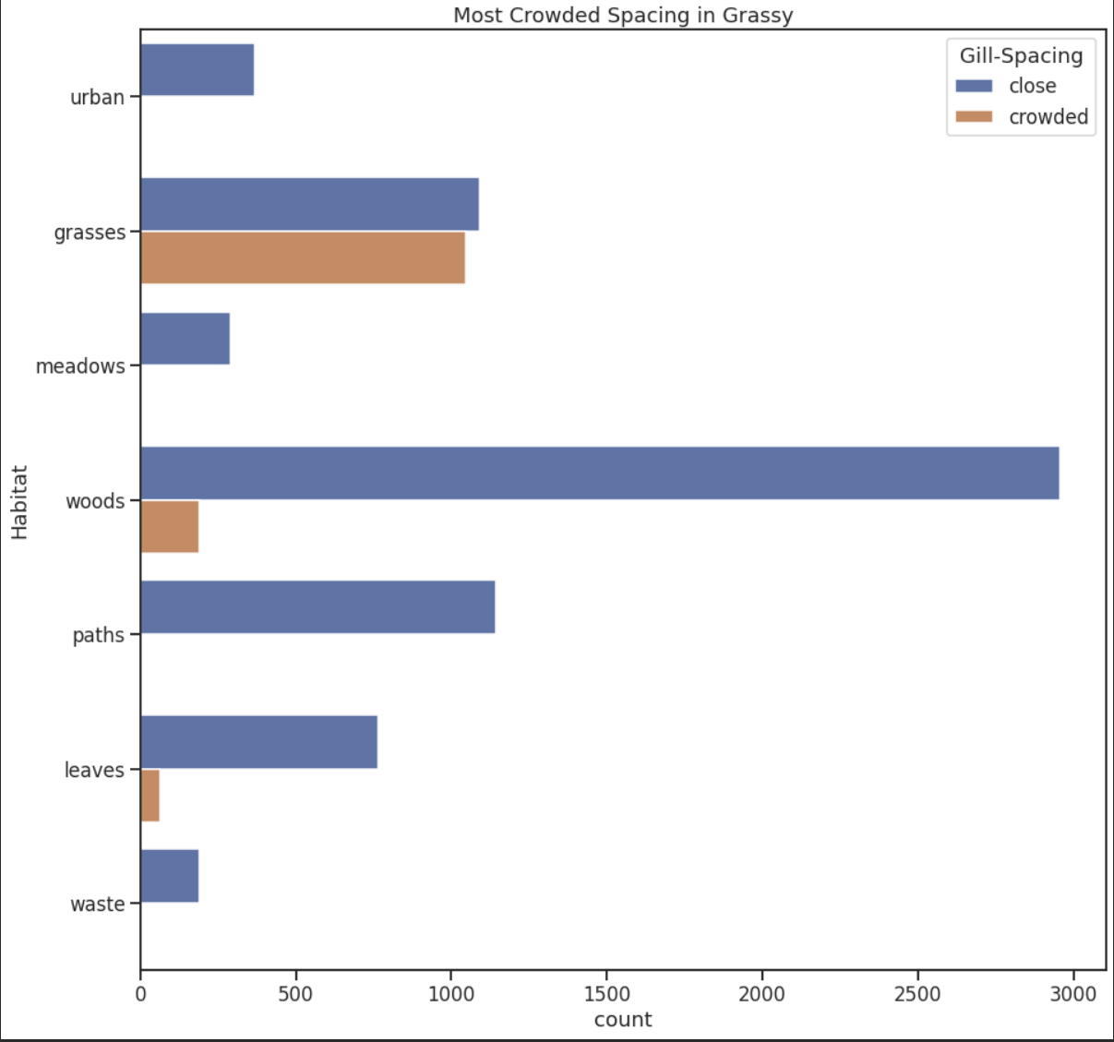
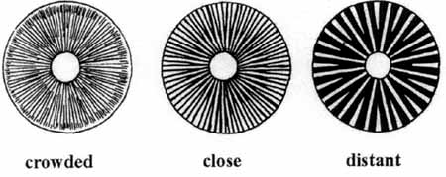
Gill Spacing and Habitat
Most mushrooms are close spacing
Grassy Areas most likely to find crowded
Notes:
Also called lamella
Often its cool to look at them cause they different patterns, like not straight, maze like
Gill spacing help with more spore disperasal of mushrooms
More gills or folds mean more surface area which mean more spores

Slide 12
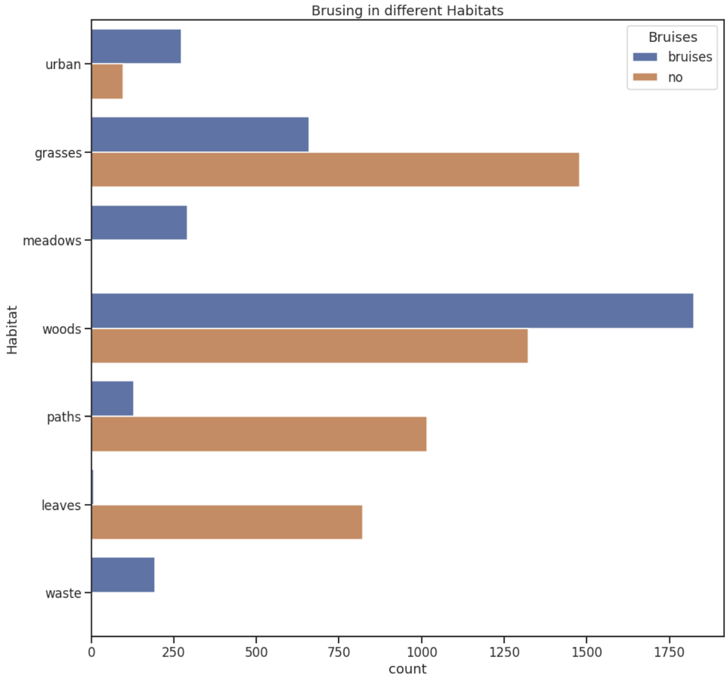
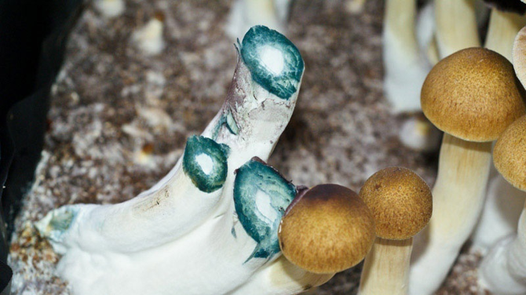
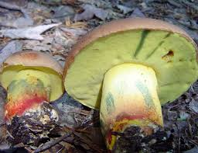
Bruising and Habitats
Waste, Meadow, Woods, Urban (bruising)
Notes:
Bruising is a reaction and makes mushrooms release some compounds (presence of oxygen)
More variety here, and it went agains my assumption with number of mushrooms and bruising; I thought there would be more instance of brusing in mushrooms but it seems relatively balanced. Areas in grassy, paths, and leaves tend to have mushrooms with no bruising; whereas wooded, urban, waste areas have mushroom with bruising. Also note that mushrooms often bruise to release chemicals or molecules; such as pychoactive ones bruise psilocin

Slide 13
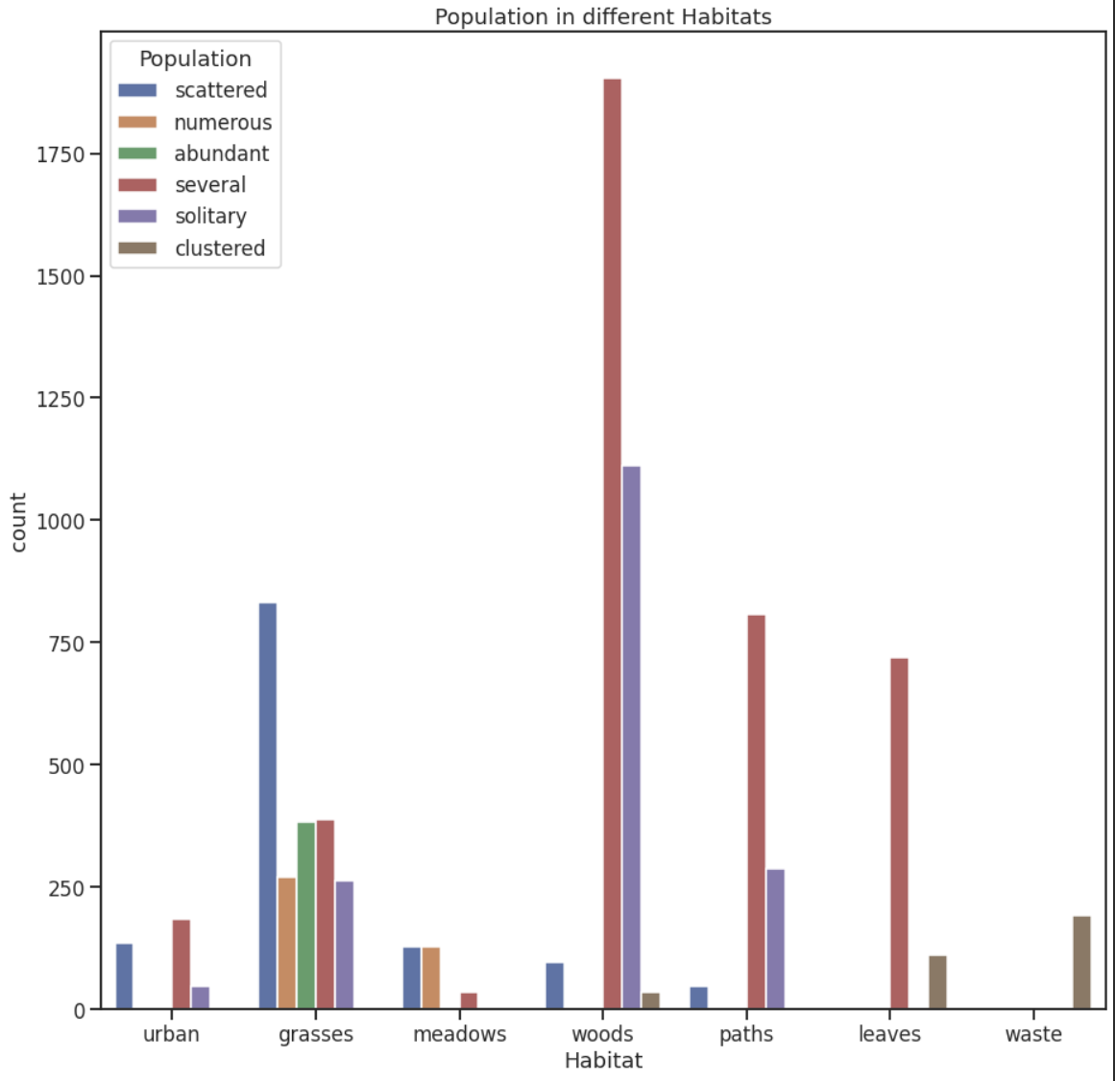
Population and Habitats
Grassy (most variety)
Scattered or Solitary (woods, habitat)
Notes:
Often finding one mushroom in an area means more may be close by

Slide 14
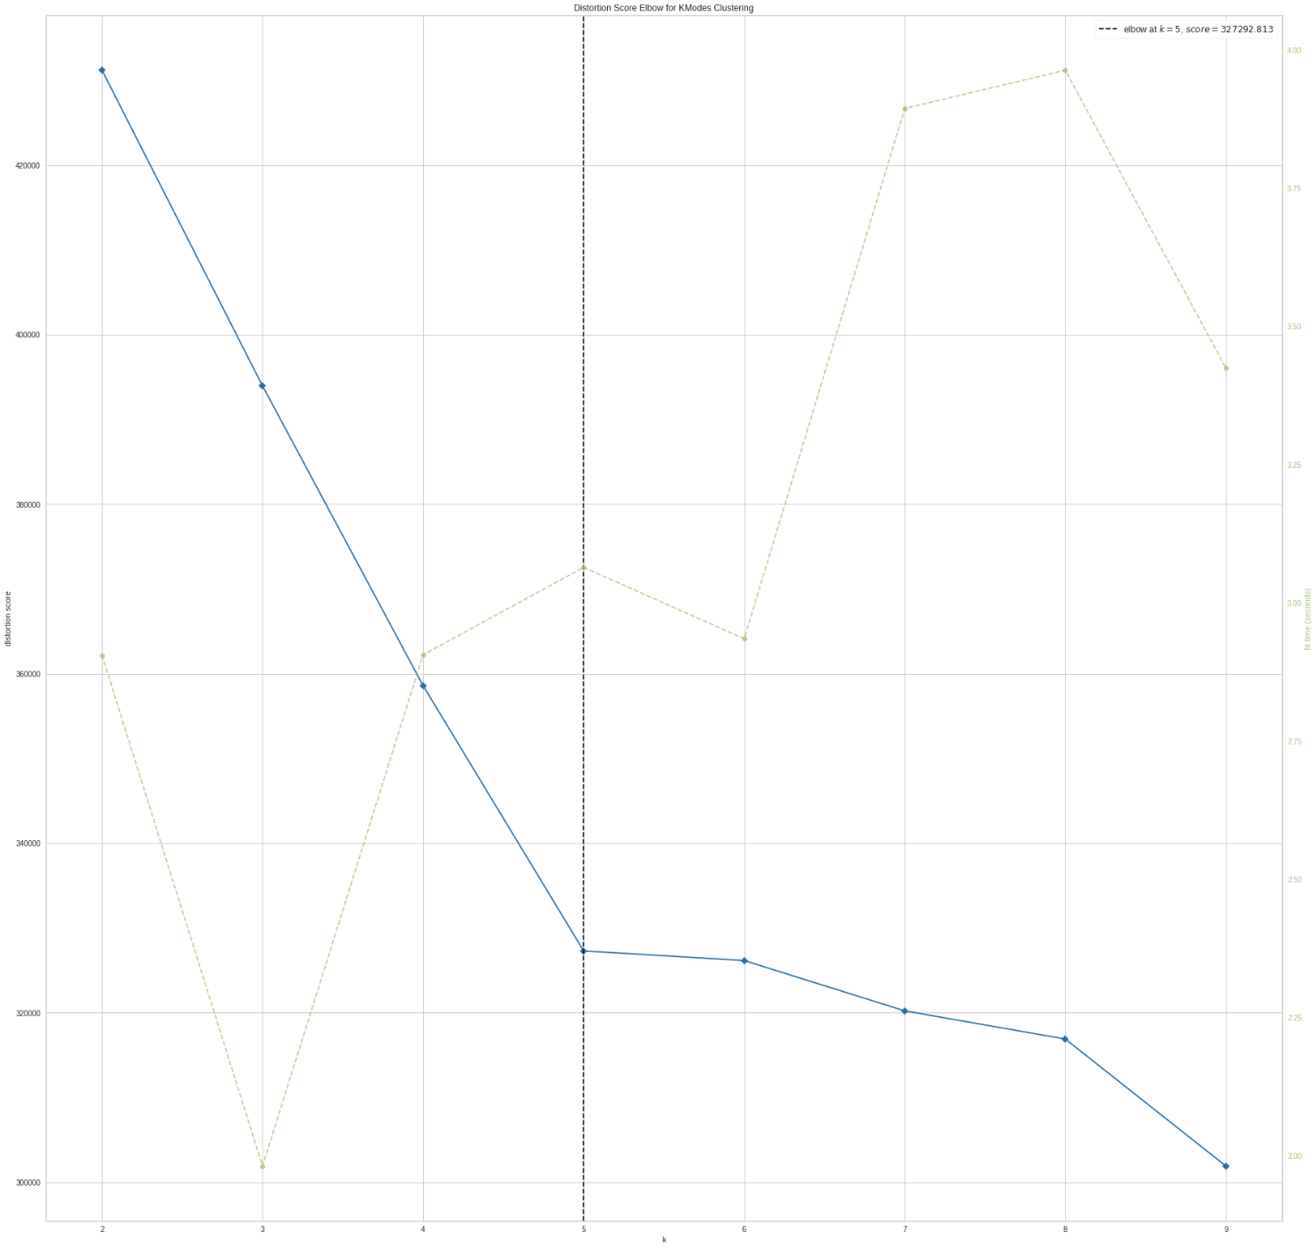
Clustering
Use Clustering to learn hidden patterns from the mushroom dataset
Preprocessing
Ordinal Encoding (save memory)
Nominal variables
K-Modes Clustering
5 Clusters

Slide 15
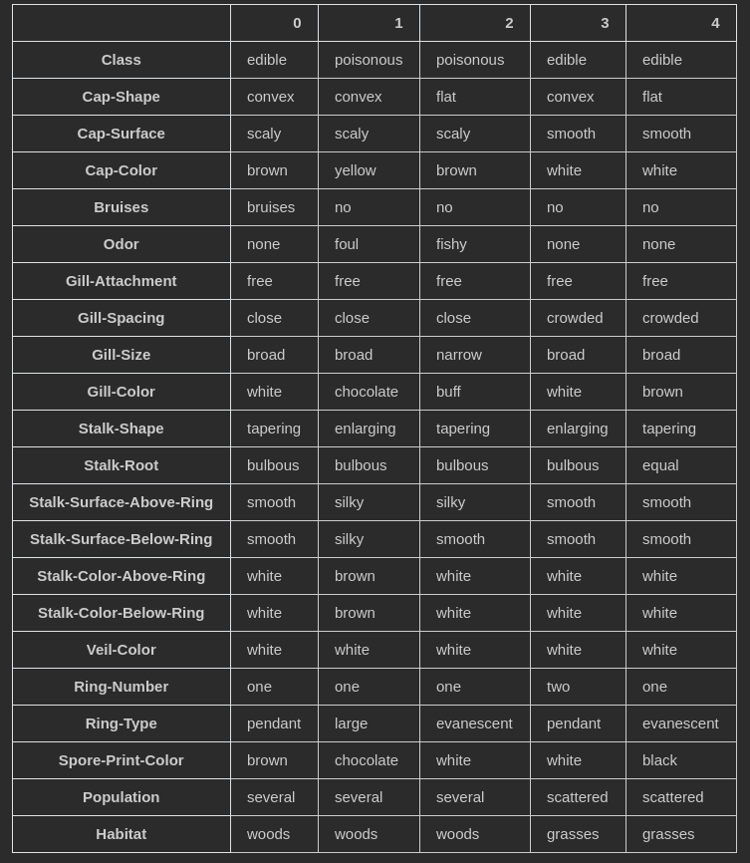
Clustering cont.
Cluster 0: edible, no odor, white gill-color, and stalk-surface-above-ring is smooth
Cluster 1: poisonous, foul odor, gray gill-color, and stalk-surface-above-ring is silky
Cluster 2: poisonous, spicy odor, buff gill color, and stalk-surface-above-ring is silky
Cluster 3: Edible, no odor, white gill color, and stalk-surface-above-ring is smooth
Cluster 4: Edible, no odor, brown gill color, and stalk-surface-above-ring is smooth
Notes:
From the 5 clusters, some prominent features noted
This pattern in analysis leads to belief that edible mushrooms will often have no smell, and have a stalk-surface-above-ring this is smooth. Other notable patterns from looking at the clusters are that mushrooms in wood habitats have serveral population, wheras grass habitat mushrooms have scattered populations, and crowded gill-spacing rather than close.

Slide 16
Preprocessing
75-25 Train-Test Split
(6093 training, 2031 Testing)
Ordinal Encoding of Features
Appropriate for Tree Models
Save Memory
Notes:
Ordinal encoding use even though categories are not ordinal of nature due to fact tree models have a behavior to perform well with ordinal encoders even when no ordering relationship is present
Also save memory over using one hot encoding

Slide 17
Modeling
Classify edibility of mushrooms based on predictor variables
Models
Decision Tree
KNN
Random Forest Classifier
5 Folds CV

Slide 18
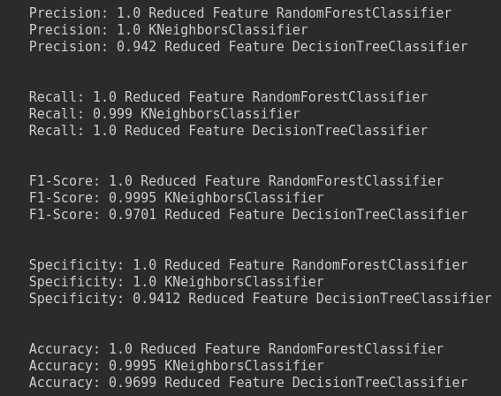
Modeling cont.
Random Forest Classifier (10 Features)
KNN uses all 21 Features
Decision Tree (3 Features)
Notes:
Precision scores refers how likely we are to predict an edible mushroom given that we said the mushroom was edible; this is because precision catches false positives, so looks at how accurate we can catch mushrooms classified as edible when it was noted as edible.
Recall score refers to how many true edible mushrooms were caught from the pool of total mushrooms that were actually edible From our situation, we want to reduce a type I error (false positives) and thus want a higher precision. So RFF, KNN, and DT had good precision of 1, which is optimal in our situation.
We look more at F1 score than accuracy even though the two metrics are identical in our scenario, we look at F1 because it is a better metric when the false negative and false positive are more crucial than the true positive and true negatives, as we do not want to detect a false positve of saying a mushroom is edible when it is not. The three models mentioned earlier does well in this category.
Specificity refers to how many mushrooms were referred to as poisonous were actually poisonous over the total number of actual poisonous mushrooms, and whie this is an important metric, precision takes priority over this metric and we shall remain on deciding either choosing dt, rf, or knn as our model of choice.
nb. ROC curves does not seem necessary to view as precisiona and recall are both 1, which signify a perfect AUC of 1.

Slide 19
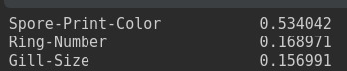
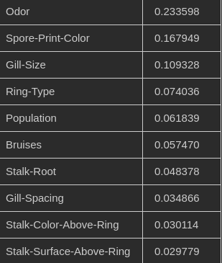
Modeling cont.
Decision Tree (3 Features)
~86% feature importance
Random Forest Classifier (10 Features)
~85% feature importance
Solution (context)
Random Forest Classifier
Notes:
Random Forest scored highest in all metrics and thus was chosen.
Even though it uses more features than DT; precision is most valuable when assessing edibility of mushrooms so RF was used even tho score similar.

Slide 20
Challenges + Future Work + Potential Insights
All data was categorical
Make own mushroom dataset with more update features and data
1981 reference books seems outdated
Amazon reviews say book was not that accurate
Insight important for consumption of mushrooms and mushroom hunters
Microscopic Examination is key

Slide 21
References
https://archive.ics.uci.edu/ml/datasets/mushroom
Images from google.com

